Slide 1
VR Controlled Robot
(VRCR)
Team Members: Eric Hinds, Levi McAdams, Zijian Song, Samuel Torres, and Tyler Allen

Slide 2
Project Description
Designing a robotic arm that is attached to a vehicular base that is controlled in VR.
The robotic arm would be able to perform tasks depending on the situation.
Be able to use the robot in locations that need human eyes to complete but not suitable for humans to be in.
Able to complete tasks with precision and accuracy
Tyler Allen 06/20/23 VRCR 1

Slide 3
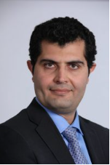


Project Clients
The clients for this project are Dr. Armin Eilaghi and Dr. Reza Razavian whom are both professors in the mechanical engineering department at NAU as well as CEIAS.
The funding for this project is supplied by CEIAS.
(figures 1, 2 ,3)
Dr. Armin Eilaghi
Dr. Reza Razavian
2

Slide 4
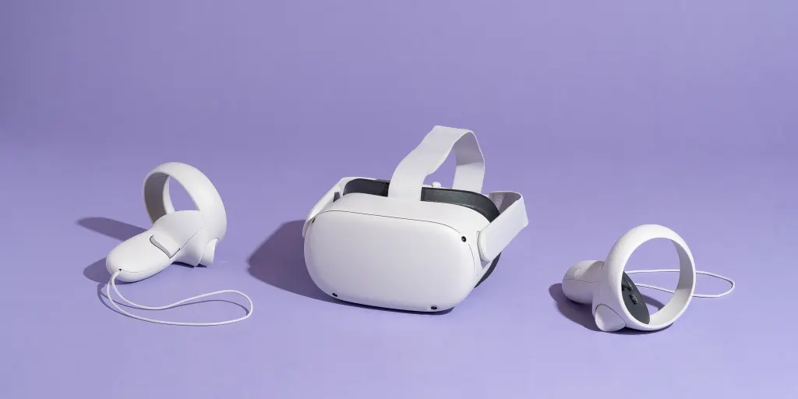
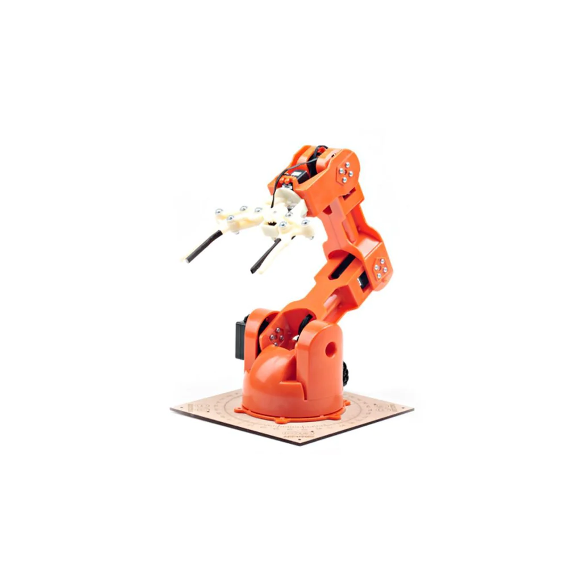
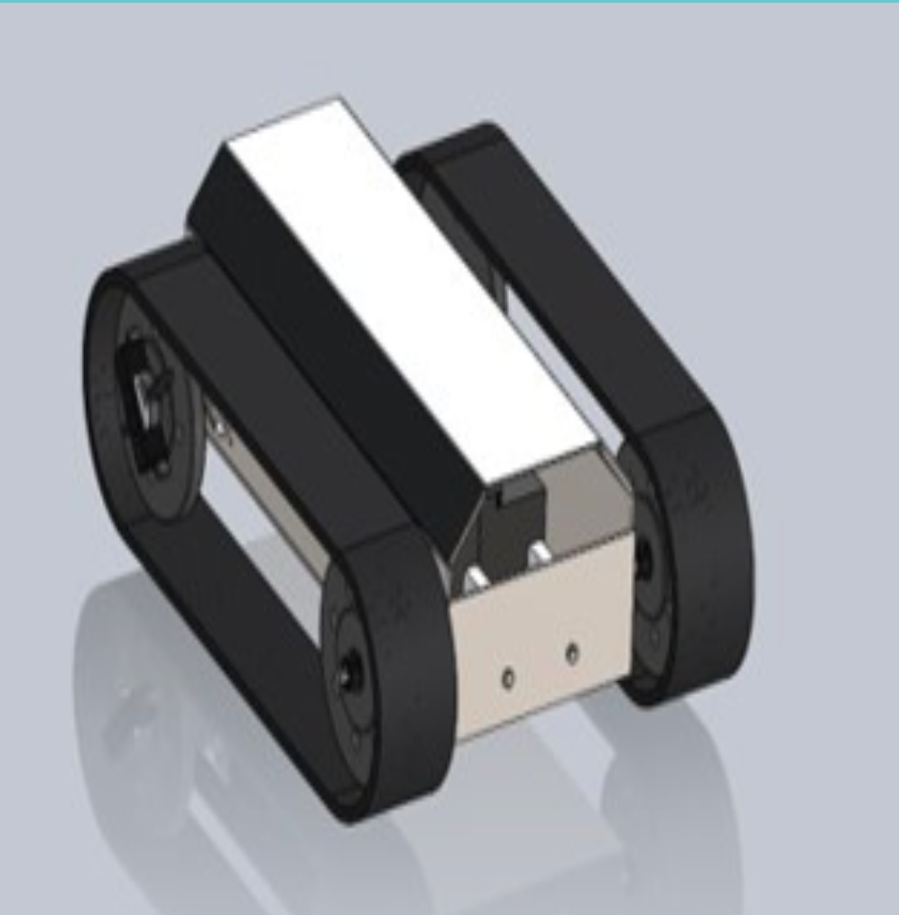
Background
“State of the Art”
VR Robot Control
“Displaced Reality”
Human machine interface
Figure 4 “VR Headset” https://www.nytimes.com/wirecutter/reviews/best-standalone-vr-headset/
Figure 6 “Arm” https://store-usa.arduino.cc/products/tinkerkit-braccio-robot
5
Figure 5 “RUT” https://www.ceias.nau.edu/capstone/projects/ME/2022/22Spr01_RobotRE/
Levi McAdams 06/20/23 VRCR 3

Slide 5
Benchmarking
Turn Test
Concrete/Wood/Carpet (any high friction surface)
Failed all test attempts to turn
Grass/Dirt
Passed - 27.21 seconds for a 180 degree turn
Levi McAdams 06/20/23 VRCR 3

Slide 6
Benchmarking

Slide 7
Current Progress
Current Progress:
Connection between VR Headset and Unity established
Key components obtained and project development process laid out
RUT

Slide 8
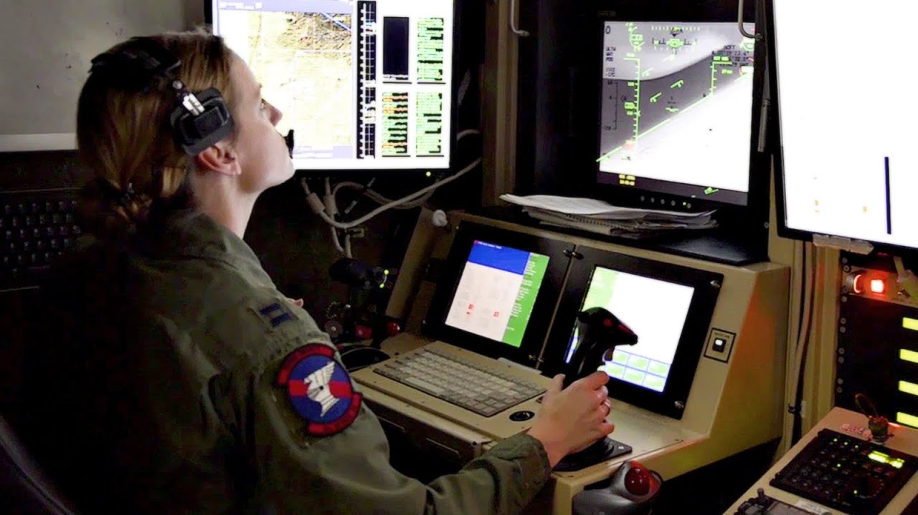
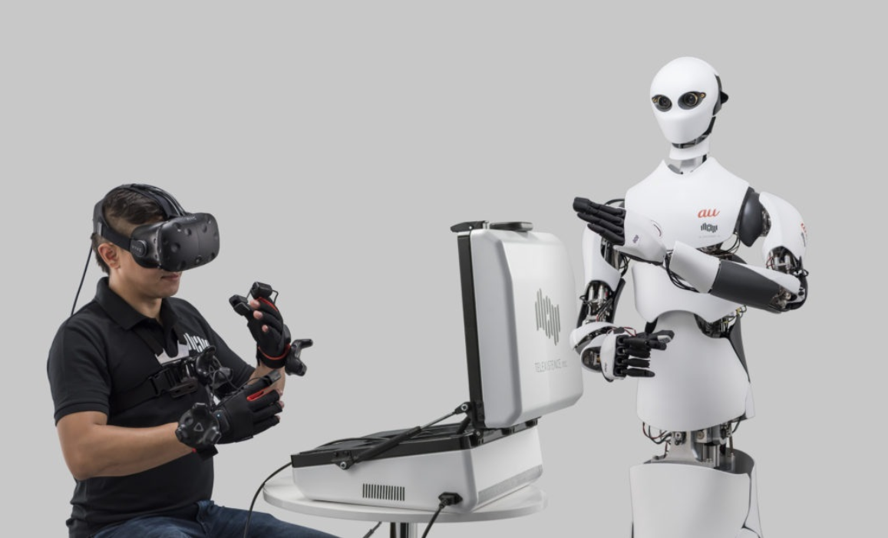
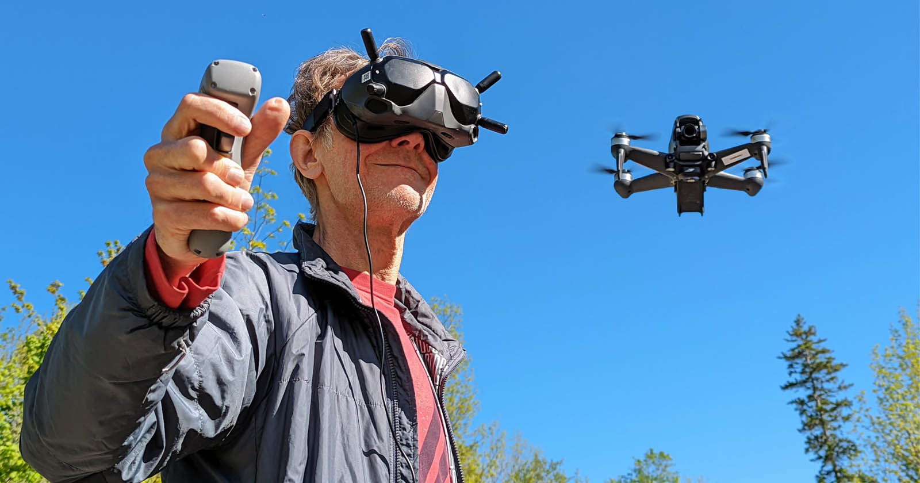
Existing Products
Examples of similar products in use today:
Military drones
Various hobby style creations published on social media
FPV Drones
4
Levi McAdams

Slide 9

VR Integration
Integration to Unity is a success
Unity is a cross platform game development engine
Using source [2] I was able to link the Meta Quest 2 headset with Unity
The software had VR compatibility, making it super easy to accommodate the very specific controls
Eric Hinds 06/20/23 VRCR 5

Slide 10
Literature Review
[1] Mechanism design and motion ability analysis for wheel/track mobile ..., https://journals.sagepub.com/doi/full/10.1177/1687814016679763 (accessed Jun. 18, 2023). A manual for analysis and design process for track based systems
[2] VR headset setup into Unity, https://www.youtube.com/watch?v=yxMzAw2Sg5w
[3] Robot Utility Tank, https://www.ceias.nau.edu/capstone/projects/ME/2022/22Spr01_RobotRE/
[4]“Free CAD Designs, Files & 3D Models | The GrabCAD Community Library,” grabcad.com. https://grabcad.com/library/arduino-braccio-robotic-arm-1 (accessed Jun. 20, 2023).
[5] NAU, “VR controlled robot capstone (1).docx,” Canvas, Jun. 05, 2023.
Samuel Torres 06/20/23 VRCR 6

Slide 11
Customer Requirements
Move in 3D
Large Workspace
Uniform Force capacity >5-10 N
High mechanical stiffness
High durability and reproducible
High-resolution sensing
Low-latency
Fast update rate
Zijian Song 06/20/23 VRCR 7

Slide 12
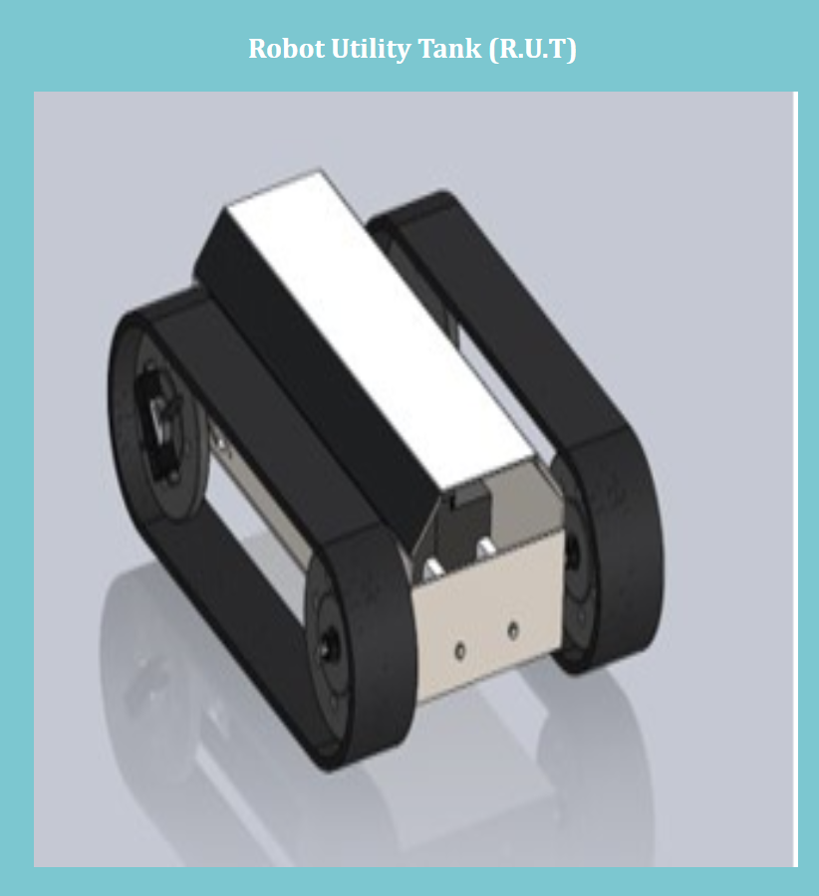
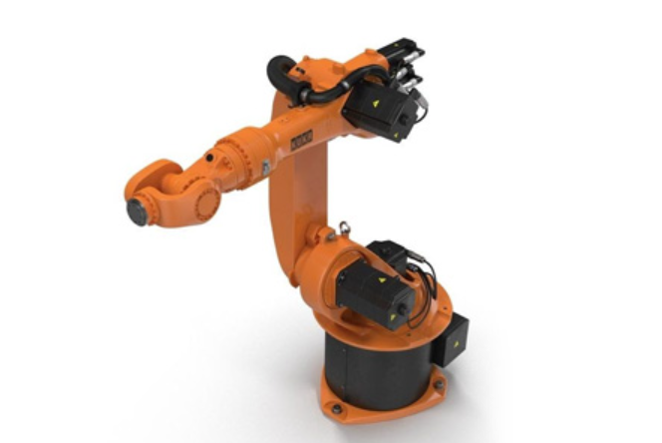
Engineering Requirements
Robot Utility Tank (RUT)
Turn radius within 2 m when full speed to apply for indoor operation
Turn speed over 35 deg/s below 70 deg/s to be flexible and operable
Robotic Arm
At least 55 Mpa ultimate strength for material
At least 10 Nm torque in each junction to hold and move an object around 1kg smoothly
At least 0.5 m radius of workspace
Zijian Song 06/20/23 VRCR 8

Slide 13
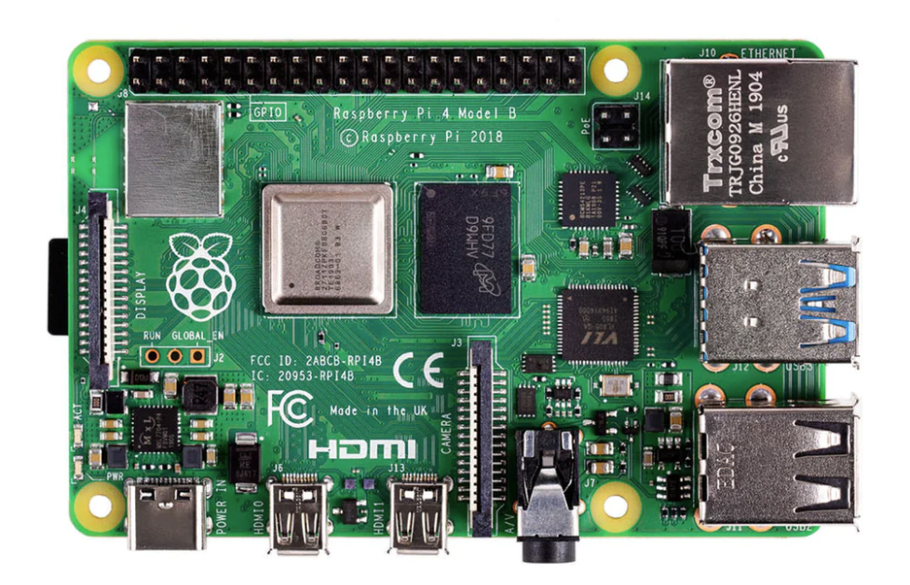
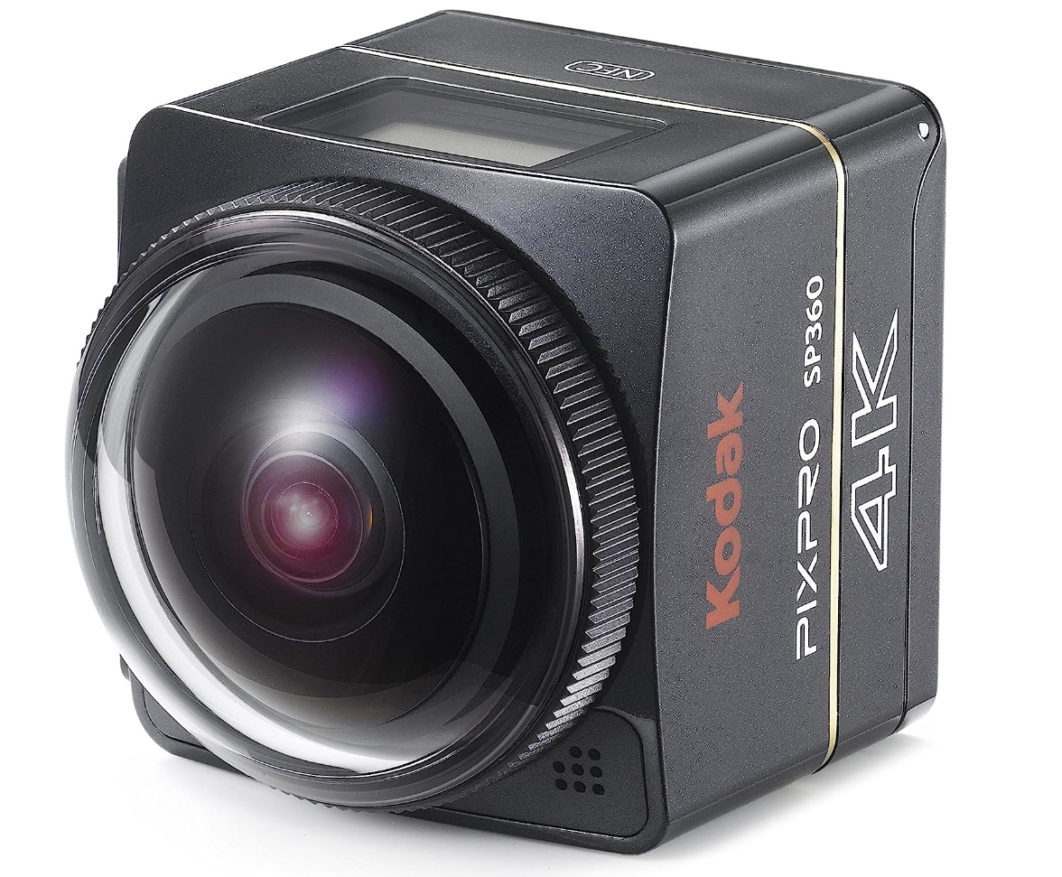
Engineering Requirements
Raspberry Pi
An integrated computer for all-in-one control system
Latency due to programming belows 20ms
Remote control through laptop/mobile hotspot
Latency need to be under 20ms
Panoramic View Camera
3D camera or 2D camera set
Zijian Song 06/20/23 VRCR 9

Slide 14
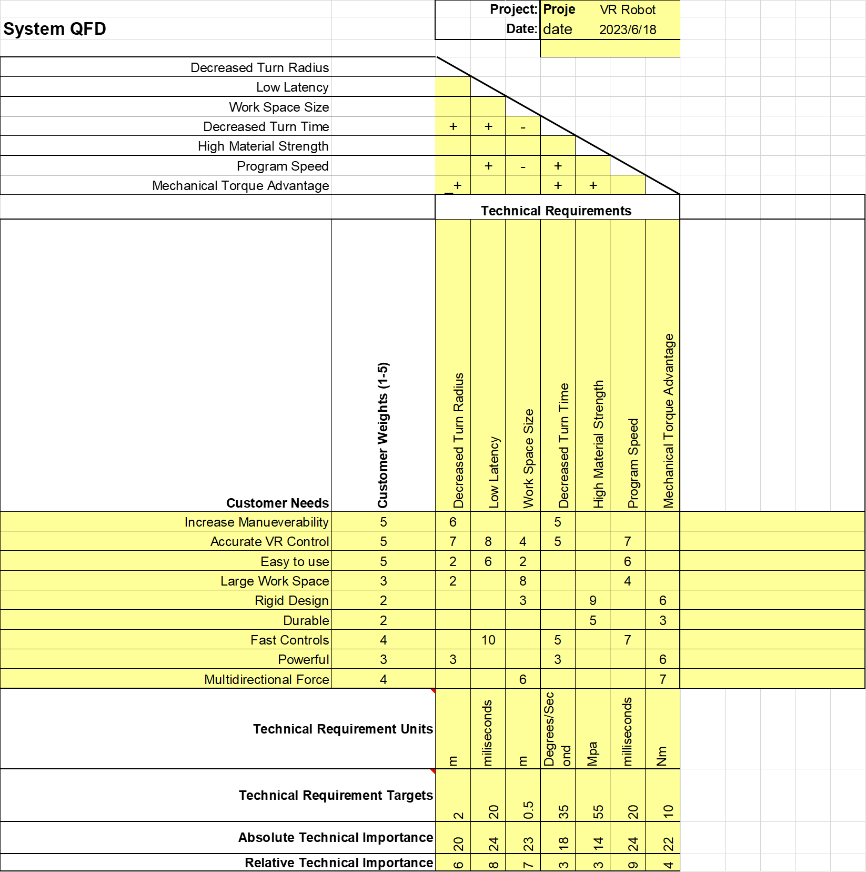
QFD
Important to have low latency, high program speed, and a large workspace
Mobility affects the difficulty of using
Mechanical torque affects the weight of object allowed directly
Zijian Song 06/20/23 VRCR 10

Slide 15
Schedule
VR Robot Arm | June |  |  |  | July |  |  |  | August
 | Week | Week | Week | Week | Week | Week | Week | Week | Week | Week
Task | 1 | 2 | 3 | 4 | 5 | 6 | 7 | 8 | 9 | 10
Research VR
Improve RUT
Research arm
Buy/build arm
Buy VR headset
Buy cameras
Attach arm to RUT
Assemble all parts
Test
Samuel Torres 06/20/23 VRCR 11

Slide 16
Starting BOM
BOM Level | P/N | Part Name | Description | Quantity | UOM | Price | Exporter
1 | T05000 | Tinkerkit Braccio Robot | A fully operational robotic arm, of which the team has had practice using thanks to generous loaners from the school. | 1 | Each | $100.99 | Arrow
1 | 899-00182-02 | Oculus Quest 2 | Fully immersive VR headset and controllers. Built for ease of use, and wifi connection friendly. | 1 | Each | $299.99 | Walmart / Target
1 | OS30A | YDLIDAR 3D Depth Camera | 3D camera used to implement 3D tracking into the Unity game (for VR integration). | 1 | Each | $139.00 | YDLIDAR
2 | SC15184 | Raspberry Pi 4 | Small, single board computer designed as a means to connect everything in the project together. | 1 | Each | $69.90 | Amazon
Eric Hinds 06/20/23 VRCR 12

Slide 17
Budget
Current Budget | Expenses to Date | Future Expenses | Extra
$2000 | $610 | $500 | $890
[5] “Gore | Improving lives through advanced materials,” Gore.com, 2015. https://www.gore.com/
Samuel Torres 06/20/23 VRCR 13

Slide 18
Thank You
14

Slide 19
References
[1] Raspberry Pi, https://raspbery-pi.com/
[2] Robotic Arm Mechanism, https://www.evsint.com/robotic-arm-mechanism/
[3] Easy Ways to Connect Raspberry Pi Remotely, https://linuxhint.com/5-ways-connect-raspberry-pi-remotely/
[4] “Gore | Improving lives through advanced materials,” Gore.com, 2015. https://www.gore.com/
15

Slide 20
Questions?
16

Slide 21
Potential Questions 1

Slide 22
Potential Questions 2

Slide 23
Potential Questions 3

Slide 24
Potential Questions 4

Slide 25
Potential Questions 5

